Slide 1






Nth Order Linear ODE
$$a_{n}\left(x\right)\left(\frac{d^{n}y}{dx^{n}}\right)+a_{n−1}\left(x\right)\left(\frac{d^{n−1}y}{dx^{n−1}}\right)+…+a_{1}\left(x\right)\left(\frac{dy}{dx}\right)+a_{0}\left(x\right)y=g(x)$$
1st Order Linear (1st Degree Term ONLY)
Separable Variables
$$a_{1}\left(x\right)\frac{dy}{dx}=g(x)$$
$$\frac{dy}{dx}=g(x)$$
$$\frac{dy}{dx}=g\left(x\right)h\left(y\right)$$
1st Order Linear (All terms)
$$a_{1}\left(x\right)\frac{dy}{dx}+a_{0}\left(x\right)y=g(x)$$
$$\frac{dy}{dx}+p\left(x\right)y=g(x)$$

Slide 2



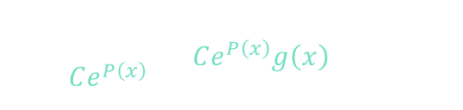
















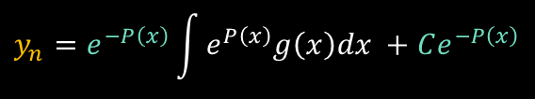






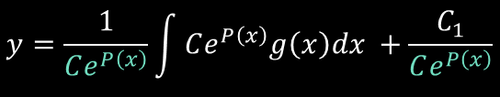

1st Order Linear
1. Multiply by “integrating-factor” to resemble Product Rule
2. Integrate, undo product by dividing “integrating-factor”
$$\frac{dy}{dx}+p\left(x\right)y=g(x)$$
3. Solve for integrating factor
Nonhomogeneous
4. Substitute, simplify, solve
$$y^{′}+py=g$$
$$u^{′}=up$$
$$y=\frac{1}{Ce^{P\left(x\right)}}\left[\int{Ce^{P\left(x\right)}g\left(x\right)dx +C_{1} }\right]$$
Integrating Factor
Product Rule
$$uy^{′}+upy=ug$$
$$\frac{du}{dx}=up\left(x\right)$$
$${\left(uy\right)}^{′}=uy^{′}+u^{′}y$$
$$u=Ce^{P\left(x\right)}$$
$$u^{′}y$$
$$y=\frac{1}{Ce^{P\left(x\right)}}\int{Ce^{P\left(x\right)}g\left(x\right)dx }+\frac{C_{1}}{Ce^{P\left(x\right)}}$$
$$uy=\int{ugdx }+C_{1}$$
$$y=\frac{1}{u}\left[\int{ugdx+C_{1} }\right]$$
$${\left(uy\right)}^{′} = ug$$
$$dx$$
$$dx$$
$$y_{n}=e^{−P\left(x\right)}\int{e^{P\left(x\right)}g\left(x\right)dx }+Ce^{−P\left(x\right)}$$
$$\frac{dy}{dx}+p\left(x\right)y=0$$
$$y_{p}$$
$$y_{h}$$
Homogeneous
Particular
Solution
$$\frac{dy}{dx}=−p\left(x\right)y$$
$$\frac{dy}{y}= −p\left(x\right)dx$$
$$y_{h}=Ce^{−P\left(x\right)}$$
$$\ln\left|y\right|= −P\left(x\right)+C$$
$$e$$
$$e^{\left( \right)}$$

Slide 3

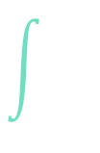










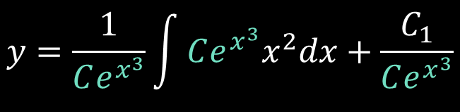



















Example 1
$$u^{′}=3x^{2}u$$
$$\ln\left|u\right|=x^{3}$$
$$u=Ce^{P\left(x\right)}$$
$$\frac{dy}{dx}+p\left(x\right)y=g(x)$$
$$y^{′}+3x^{2}y=x^{2}$$
$$\frac{du}{dx}=3x^{2}u$$
$$u=Ce^{x^{3}}$$
$$p\left(x\right)=3x^{2}$$
$$P\left(x\right)=x^{3}$$
$$p\left(x\right)$$
$$g\left(x\right)$$
$$uy^{′}+u3x^{2}y=ux^{2}$$
$$v=x^{3}$$
$$x^{2}dx=\frac{dv}{3}$$
$$\frac{du}{u}= 3x^{2}dx$$
$$dv=3x^{2}dx$$
$$u^{′}y$$
$$y=\frac{1}{Ce^{x^{3}}}\int{Ce^{x^{3}}x^{2}dx}+\frac{C_{1}}{Ce^{x^{3}}}$$
$${\left(uy\right)}^{′} = ux^{2}$$
$$dx$$
$$y=\frac{e^{v}}{3e^{x^{3}}}+\frac{C}{e^{x^{3}}}$$
$$dx$$
$$uy=\int{ux^{2}dx}+C_{1}$$
$$y=\frac{1}{e^{x^{3}}}\int{e^{x^{3}}x^{2}dx}+\frac{C}{e^{x^{3}}}$$
$$y=\frac{e^{x^{3}}}{3e^{x^{3}}}+\frac{C}{e^{x^{3}}}$$
$$y=\frac{1}{u}\int{ux^{2}dx}+\frac{C_{1}}{u}$$
$$y=\frac{1}{e^{x^{3}}}\int{\frac{e^{v}dv}{3}}+\frac{C}{e^{x^{3}}}$$
$$y=\frac{1}{3}+Ce^{−x^{3}}$$

Slide 4





Example 1
$$y^{′}+3x^{2}y=x^{2}$$
$$y=\frac{1}{3}+Ce^{−x^{3}}$$
$$y_{h}$$
$$y_{p}$$
$$y_{h}=Ce^{−P\left(x\right)}$$
$$y^{′}+3x^{2}y=0$$

Slide 5








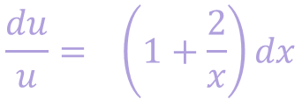


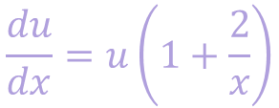

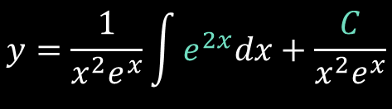

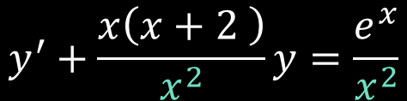







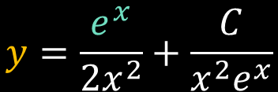
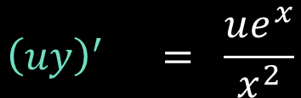

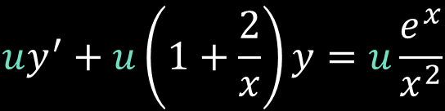

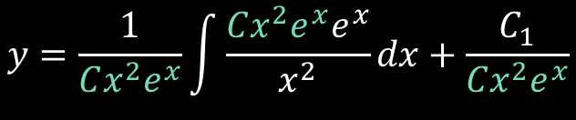

Example 2
$$u^{′}=u\left(1+\frac{2}{x}\right)$$
$$P\left(x\right)$$
$$\frac{dy}{dx}+p\left(x\right)y=g(x)$$
$$x^{2}y^{′}+x\left(x+2 \right)y=e^{x}$$
$$u=e^{x+2\ln\left|x\right|+C}$$
$$\frac{du}{dx}=u\left(1+\frac{2}{x}\right)$$
$$u=e^{x}e^{2\ln\left|x\right|}e^{C}$$
$$y^{′}+\frac{x\left(x+2 \right)}{x^{2}}y=\frac{e^{x}}{x^{2}}$$
$$u=Ce^{P\left(x\right)}$$
$$u=Ce^{\ln\left|x^{2}\right|}e^{x}$$
$$u=Cx^{2}e^{x}$$
$$y^{′}+\left(1+\frac{2}{x}\right)y=\frac{e^{x}}{x^{2}}$$
$$\frac{du}{u}= \left(1+\frac{2}{x}\right)dx$$
$$y=\frac{1}{Cx^{2}e^{x}}\int{\frac{Cx^{2}e^{x}e^{x}}{x^{2}}dx}+\frac{C_{1}}{Cx^{2}e^{x}}$$
$$\ln\left|u\right|=x+2\ln\left|x\right|+C$$
$$p\left(x\right)$$
$$g\left(x\right)$$
$$y=\frac{1}{x^{2}e^{x}}\int{e^{2x}dx}+\frac{C}{x^{2}e^{x}}$$
$${\left(uy\right)}^{′} = \frac{ue^{x}}{x^{2}}$$
$$uy^{′}+u\left(1+\frac{2}{x}\right)y=u\frac{e^{x}}{x^{2}}$$
$$dx$$
$$dx$$
$$y=\frac{e^{2x}}{2x^{2}e^{x}}+\frac{C}{x^{2}e^{x}}$$
$$y=\frac{1}{u}\int{\frac{ue^{x}}{x^{2}}dx}+\frac{C_{1}}{u}$$
$$u^{′}$$
$$y=\frac{e^{x}}{2x^{2}}+\frac{C}{x^{2}e^{x}}$$

Slide 6

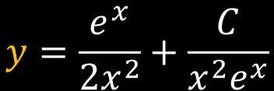




Example 2
$$x^{2}y^{′}+x\left(x+2 \right)y=e^{x}$$
$$y=\frac{e^{x}}{2x^{2}}+\frac{C}{x^{2}e^{x}}$$
$$y_{p}$$
$$y_{h}$$
$$y_{h}=Ce^{−P\left(x\right)}$$
$$y=\frac{1}{x^{2}}\left(\frac{e^{x}}{2}+\frac{C}{e^{x}}\right)$$
$$x^{2}y^{′}+x\left(x+2 \right)y=0$$

Slide 7
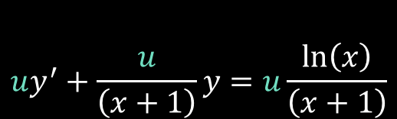
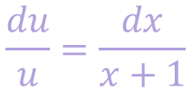
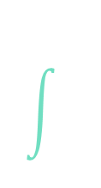





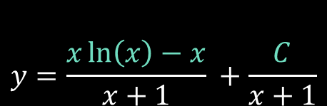





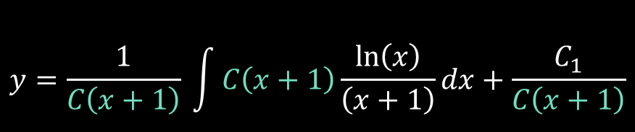
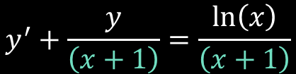








Example 3
(IVP)
$$\frac{dy}{dx}+p\left(x\right)y=g(x)$$
$$u^{′}=\frac{u}{x+1}$$
$$\left(x+1\right)y^{′}+y=\ln\left(x\right)$$
$$y\left(1\right)=10$$
$$\frac{du}{dx}=\frac{u}{x+1}$$
Product Rule
$$y^{′}+\frac{y}{\left(x+1\right)}=\frac{\ln\left(x\right)}{\left(x+1\right)}$$
$${\left(uy\right)}^{′}=uy^{′}+u^{′}y$$
$$\frac{du}{u}=\frac{dx}{x+1}$$
$$p\left(x\right)$$
$$g\left(x\right)$$
$$uy^{′}+\frac{u}{\left(x+1\right)}y=u\frac{\ln\left(x\right)}{\left(x+1\right)}$$
$$\ln\left|u\right|=\ln\left|x+1\right|+C$$
$$e^{\ln\left|u\right|}=e^{\ln\left|x+1\right|+C}$$
$$y=\frac{x\ln\left(x\right)−x}{x+1} +\frac{C}{x+1}$$
$$u=C\left(x+1\right)$$
$$u^{′}$$
$$y=\frac{1}{u} \int{u\frac{\ln\left(x\right)}{\left(x+1\right)}}dx+\frac{C_{1}}{u}$$
$${\left(uy\right)}^{′} = u\frac{\ln\left(x\right)}{\left(x+1\right)}$$
$$dx$$
$$dx$$
$$uy= \int{u\frac{\ln\left(x\right)}{\left(x+1\right)}}dx+C_{1}$$
$$y=\frac{1}{C\left(x+1\right)} \int{C\left(x+1\right)\frac{\ln\left(x\right)}{\left(x+1\right)}}dx+\frac{C_{1}}{C\left(x+1\right)}$$

Slide 8

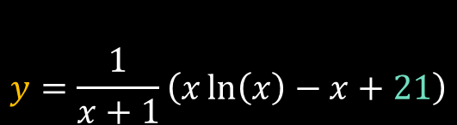






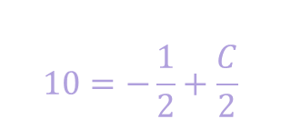
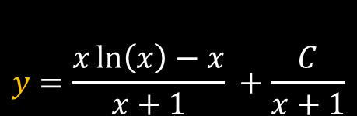
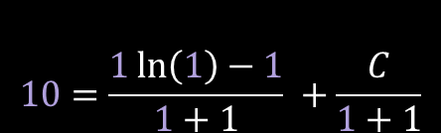
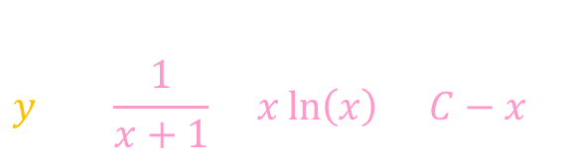
Example 3
(IVP)
$$\left(x+1\right)y^{′}+y=\ln\left(x\right)$$
$$y\left(1\right)=10$$
$$y=\frac{x\ln\left(x\right)−x}{x+1} +\frac{C}{x+1}$$
$$y_{p}$$
$$y_{h}$$
$$y_{h}=Ce^{−P\left(x\right)}$$
$$\left(x+1\right)y^{′}+y=0$$
$$10=\frac{1\ln\left(1\right)−1}{1+1} +\frac{C}{1+1}$$
$$y=\frac{1}{x+1}\left(x\ln\left(x\right)−x+21\right)$$
$$y=\left(\frac{1}{x+1}\right)\left(x\ln\left(x\right)+C−x \right)$$
$$10=−\frac{1}{2}+\frac{C}{2}$$
$$C−1=20$$
$$C=21$$

Slide 9
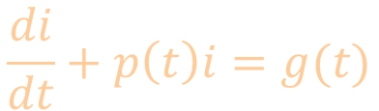
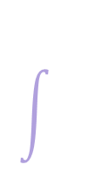












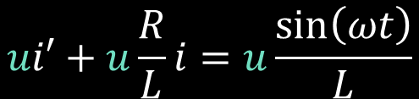

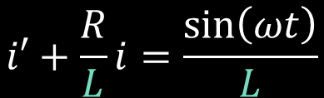


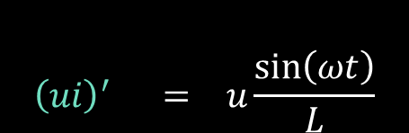

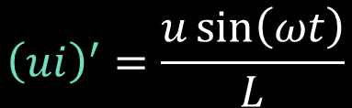

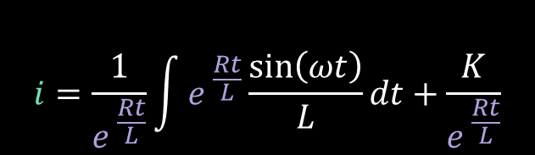



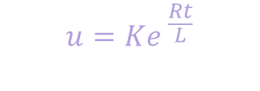

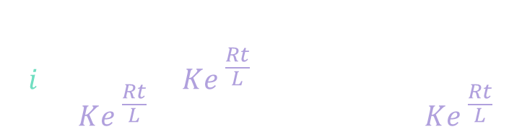
Example 4
inductor
(IVP)
$$L$$
$$\frac{di}{dt}+p\left(t\right)i=g(t)$$
$$Li^{′}+Ri=\sin\left(ωt\right)$$
$$i′+\frac{R}{L}i=\frac{\sin\left(ωt\right)}{L}$$
voltage
source
Product Rule
$$V\left(t\right)$$
$$=\sin\left(ωt\right)$$
$${\left(ui\right)}^{′}=ui^{′}+u^{′}i$$
resistance
$$p\left(t\right)$$
$$g\left(t\right)$$
$$u^{′}=\frac{R}{L}u$$
$$\frac{du}{dt}=\frac{R}{L}u$$
$$R$$
$$ui′+u\frac{R}{L}i=u\frac{\sin\left(ωt\right)}{L}$$
$$ui=\int{u\frac{\sin\left(ωt\right)}{L}dt}+K_{1}$$
$$\frac{du}{u}= \frac{R}{L}dt$$
$$\ln\left|u\right|= \frac{R}{L}t+K$$
$$u^{′}$$
$$i=\frac{1}{u}\int{u\frac{\sin\left(ωt\right)}{L}dt}+\frac{K_{1}}{u}$$
$${\left(ui\right)}^{′}=\frac{u\sin\left(ωt\right)}{L}$$
$$u=e^{ \frac{R}{L}t+K}$$
$$u=Ke^{ \frac{Rt}{L}}$$
$${\left(ui\right)}^{′} = u\frac{\sin\left(ωt\right)}{L}$$
$$i=\frac{1}{Ke^{ \frac{Rt}{L}}}\int{Ke^{ \frac{Rt}{L}}\frac{\sin\left(ωt\right)}{L}dt}+\frac{K_{1}}{Ke^{ \frac{Rt}{L}}}$$
$$i=\frac{1}{e^{ \frac{Rt}{L}}}\int{e^{ \frac{Rt}{L}}\frac{\sin\left(ωt\right)}{L}}dt+\frac{K}{e^{ \frac{Rt}{L}}}$$
$$dt$$
$$dt$$

Slide 10










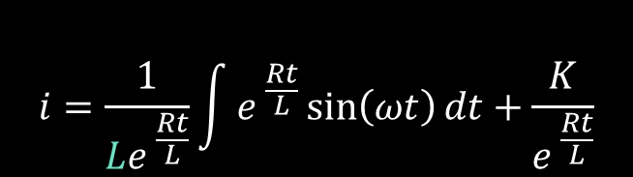



Example 4
inductor
(IVP)
$$L$$
$$u$$
$$dv$$
$$Li^{′}+Ri=\sin\left(ωt\right)$$
$$e^{ \frac{Rt}{L}}$$
$$\sin\left(ωt\right)dt$$
$$i′+\frac{R}{L}i=\frac{\sin\left(ωt\right)}{L}$$
voltage
source
$$+$$
$$V\left(t\right)$$
$$=\sin\left(ωt\right)$$
$${\frac{R}{L}e}^{ \frac{Rt}{L}}$$
$$−\frac{\cos\left(ωt\right)dt}{ω}$$
resistance
$$−$$
$$p\left(t\right)$$
$$g\left(t\right)$$
$$R$$
$${\frac{R^{2}}{L^{2}}e}^{ \frac{Rt}{L}}$$
$$−\frac{\sin\left(ωt\right)dt}{ω^{2}}$$
$$i=\frac{1}{Le^{ \frac{Rt}{L}}}\int{e^{ \frac{Rt}{L}}\sin\left(ωt\right)}dt+\frac{K}{e^{ \frac{Rt}{L}}}$$
$$+$$
$$u$$
$$dv$$
$$\int{e^{ \frac{Rt}{L}}\sin\left(ωt\right)}dt=\left(+1\right)\left(e^{\frac{Rt}{L}}\right)\left(−\frac{\cos\left(ωt\right)}{ω}\right)+\left(−1\right)\left(\frac{R}{L}e^{\frac{Rt}{L}}\right)\left(−\frac{\sin\left(ωt\right)}{ω^{2}}\right)+\int{\left({\frac{R^{2}}{L^{2}}e}^{ \frac{Rt}{L}}\right)\left(−\frac{\sin\left(ωt\right)dt}{ω^{2}}\right)}$$

Slide 11








$$\int{e^{ \frac{Rt}{L}}\sin\left(ωt\right)}dt=\left(+1\right)\left(e^{\frac{Rt}{L}}\right)\left(−\frac{\cos\left(ωt\right)}{ω}\right)+\left(−1\right)\left(\frac{R}{L}e^{\frac{Rt}{L}}\right)\left(−\frac{\sin\left(ωt\right)}{ω^{2}}\right)+\int{\left({\frac{R^{2}}{L^{2}}e}^{ \frac{Rt}{L}}\right)\left(−\frac{\sin\left(ωt\right)dt}{ω^{2}}\right)}$$
$$\int{e^{ \frac{Rt}{L}}\sin\left(ωt\right)}dt=−\frac{1}{ω}e^{ \frac{Rt}{L}}\cos\left(ωt\right)+\frac{R}{Lω^{2}}e^{ \frac{Rt}{L}}\sin\left(ωt\right)+\frac{R^{2}}{L^{2}ω^{2}}\int{e^{ \frac{Rt}{L}}\sin\left(ωt\right)dt}$$
I
$$k$$
I
$$I=−\frac{1}{ω}e^{ \frac{Rt}{L}}\cos\left(ωt\right)+\frac{R}{Lω^{2}}e^{ \frac{Rt}{L}}\sin\left(ωt\right)+kI$$
$$I=\frac{\left(−\frac{1}{ω}e^{ \frac{Rt}{L}}\cos\left(ωt\right)+\frac{R}{Lω^{2}}e^{ \frac{Rt}{L}}\sin\left(ωt\right)\right)}{1−\frac{R^{2}}{L^{2}ω^{2}}}$$
$$\frac{L^{2}ω^{2}}{L^{2}ω^{2}}$$
$$I−kI=−\frac{1}{ω}e^{ \frac{Rt}{L}}\cos\left(ωt\right)+\frac{R}{Lω^{2}}e^{ \frac{Rt}{L}}\sin\left(ωt\right)$$
$$I=\frac{\left(−L^{2}ωe^{ \frac{Rt}{L}}\cos\left(ωt\right)+LRe^{ \frac{Rt}{L}}\sin\left(ωt\right)\right)}{L^{2}ω^{2}−R^{2}}$$
$$I=\frac{\left(−\frac{1}{ω}e^{ \frac{Rt}{L}}\cos\left(ωt\right)+\frac{R}{Lω^{2}}e^{ \frac{Rt}{L}}\sin\left(ωt\right)\right)}{1−k}$$
$$I=\left(\frac{Le^{\frac{Rt}{L}}}{L^{2}ω^{2}−R^{2}}\right)\left(R\sin\left(ωt\right)−Lω\cos\left(ωt\right)\right)$$

Slide 12


Example 4
inductor
(IVP)
$$L$$
$$u$$
$$dv$$
$$Li^{′}+Ri=\sin\left(ωt\right)$$
$$e^{ \frac{Rt}{L}}$$
$$\sin\left(ωt\right)dt$$
$$i′+\frac{R}{L}i=\frac{\sin\left(ωt\right)}{L}$$
voltage
source
$$+$$
$$V\left(t\right)$$
$$=\sin\left(ωt\right)$$
$${\frac{R}{L}e}^{ \frac{Rt}{L}}$$
$$−\frac{\cos\left(ωt\right)dt}{ω}$$
resistance
$$−$$
$$p\left(t\right)$$
$$g\left(t\right)$$
$$R$$
$${\frac{R^{2}}{L^{2}}e}^{ \frac{Rt}{L}}$$
$$−\frac{\sin\left(ωt\right)dt}{ω^{2}}$$
$$i=\frac{1}{Le^{ \frac{Rt}{L}}}\int{e^{ \frac{Rt}{L}}\sin\left(ωt\right)}dt+\frac{K}{e^{ \frac{Rt}{L}}}$$
$$+$$
$$u$$
$$dv$$
$$i=\frac{R\sin\left(ωt\right)−Lω\cos\left(ωt\right)}{L^{2}ω^{2}−R^{2}}+\frac{K}{e^{ \frac{Rt}{L}}}$$
$$i=\frac{1}{Le^{ \frac{Rt}{L}}}\left(\frac{Le^{\frac{Rt}{L}}}{L^{2}ω^{2}−R^{2}}\right)\left(R\sin\left(ωt\right)−Lω\cos\left(ωt\right)\right)+\frac{K}{e^{ \frac{Rt}{L}}}$$

Slide 13








Example 4
(IVP)
$$Li^{′}+Ri=\sin\left(ωt\right)$$
$$i=\frac{R\sin\left(ωt\right)−Lω\cos\left(ωt\right)}{L^{2}ω^{2}−R^{2}}+Ke^{−\frac{Rt}{L}}$$
$$i_{h}$$
$$i_{p}$$
$$Li^{′}+Ri=0$$
inductor
$$L$$
voltage
source
$$=\sin\left(ωt\right)$$
$$V\left(t\right)$$
resistance
$$R$$

